Slide 1
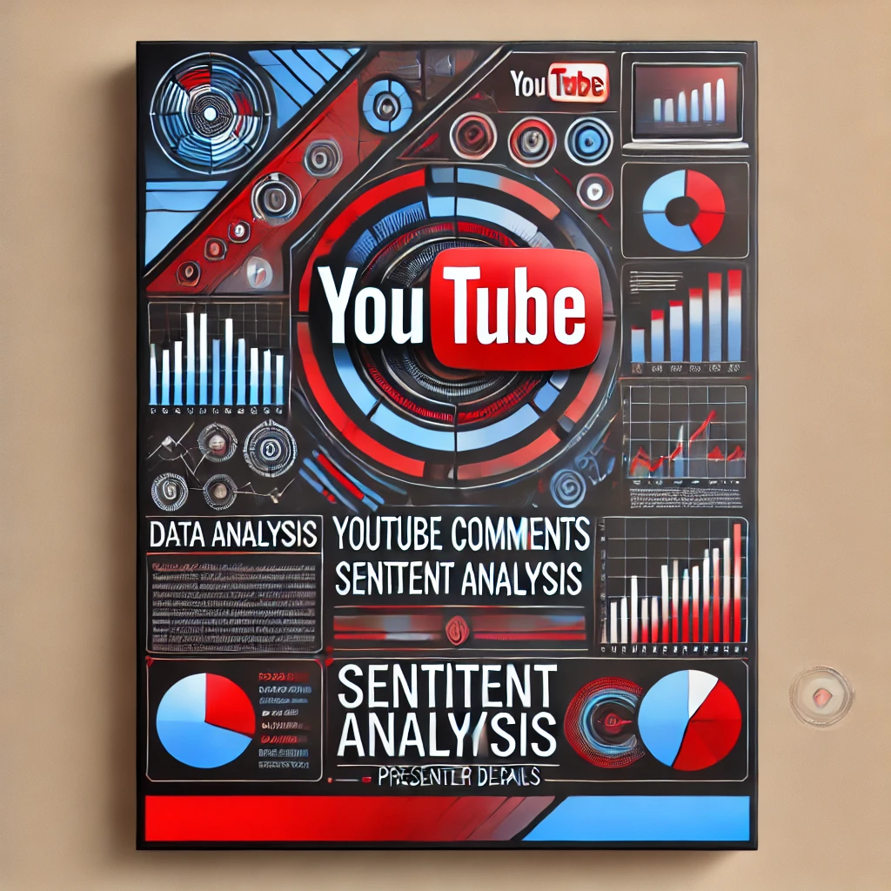
YouTube Comments Sentiment Analysis
Presented By:
Nowshin Nawal Mim
ID: 1911054042
Mossran Tahmid khan
ID: 1821117042

Slide 2
Project overview
Our project aims to perform sentiment analysis on YouTube comments using machine learning techniques. With the exponential growth of YouTube as a platform for content consumption, analyzing user comments becomes crucial for content creators, marketers, and researchers to understand audience sentiment, engagement, and preferences..

Slide 3
Project Overview
Objective
To analysis YouTube comments and extract sentiment insight using ML techniques.
Methods & techniques
Employ Natural Language Processing(NLP) algorithms to classify comments as positive negative or neutral.
Significance of Findings
Provide insights for content creators,marketers & researchers to enhance audience engagements and improve content strategies.

Slide 4
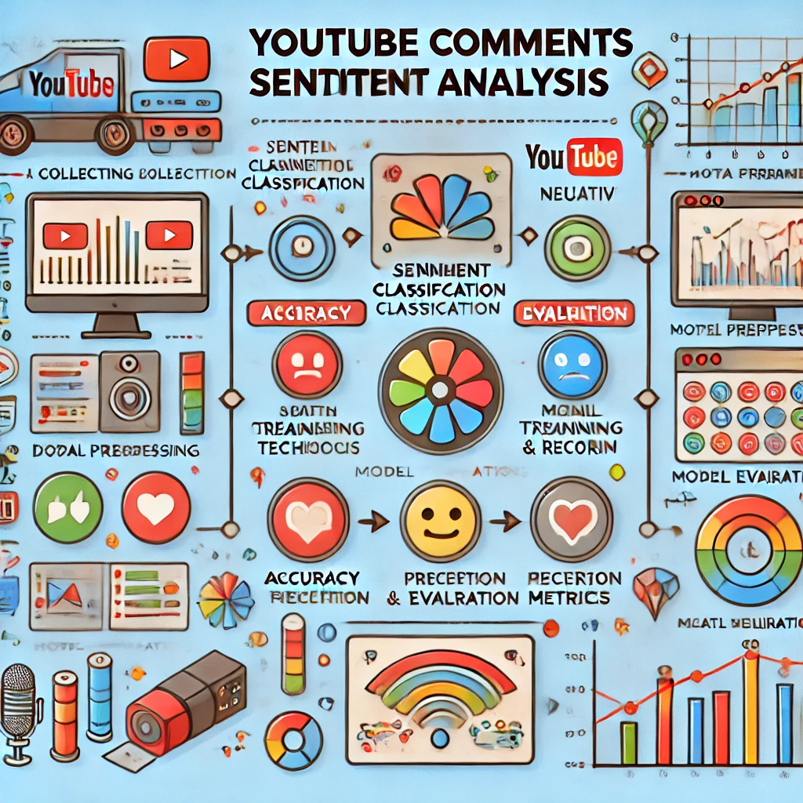
Sentiment Analysis Overview

Slide 5
Charts and Graphs of Sentiment Analysis

Slide 6
Data Collection and Preprocessing
Data Collection: Gather diverse datasets of YouTube comments across different channels and genres.
Preprocessing: Clean and preprocess the comments data to remove noise and irrelevant information.
Techniques: Tokenization, Lemmatization, Removal of stop words.

Slide 7
Project Walkthrough
Steps:
Collect and preprocess YouTube comment datasets.
Split data into training and test sets.
Train models for sentiment classification.
Generate summaries for the comments.
Create images from the summaries and match them to the related video content.

Slide 8
tools and Technologies Used
Programming Language: Python
NLP Libraries:
Natural Language Toolkit (NLTK)
spaCy
TextBlob
Machine Learning Frameworks:
Scikit-learn
TensorFlow
Keras
Web Technologies: HTML, CSS for front-end development.

Slide 9
Results and Analysis
Sentiment Classification Results:
Breakdown of comments classified as positive, neutral, or negative.
Insights on audience reactions to different types of content.
Text-to-Image Example:
Present images generated from comment summaries using text-to-image generation models.
Explain how the generated images were aligned with video content (e.g., matching sentiment-related images with video scenes).

Slide 10
Challenges Faced
Sentiment Analysis:
Difficulty in handling sarcasm and slang in comments.
Data imbalance between positive, neutral, and negative comments.
Image Generation:
Ensuring image relevance to summarized text.
Matching image sentiment with video content.
Future Work
Improvements:
Improve model accuracy by using more advanced deep learning models (e.g., GPT-4).
Expand dataset to include more diverse genres and languages.
Additional Features:
Include sentiment analysis for multi-language comments.
Generate animated images or visualizations from the comment summaries.

Slide 11
Thank you. Any questions?

